Slide 1
Erçin DİNÇER
Temel Bilgisayar Ağ Teknolojileri

Slide 2
Günlük Hayatımızda Bilgisayar Ağları
Wireless
Kablolu Network
3G/4G-4.5G
DNS Ayarları

Slide 3
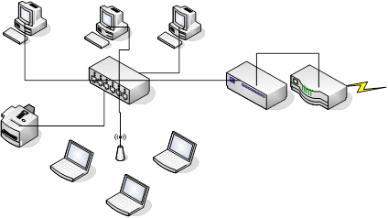
IP Adresi

Slide 4
IP Adresi
A Sinifi Adresler : 1.0.0.0 – 126.255.255.255 (00000001-01111111)
B Sinifi Adresler : 128.0.0.0 – 191.255.255.255 (10000000-10111111)
C Sinifi Adresler : 192.0.0.0 – 223.255.255.255 (11000000-11011111)
D Sinifi Adresler : 224.0.0.0 – 239.255.255.255 (11100000-11101111)
E Sinifi Adresler : 240.0.0.0 – 254.255.255.255 (11110000-11110111)
• 10.0.0.0 – 10.255.255.255 • 172.16.0.0 – 172.31.255.255 • 192.168.0.0 – 192.168.255.255

Slide 5
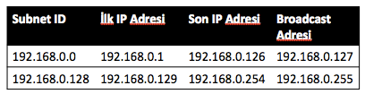
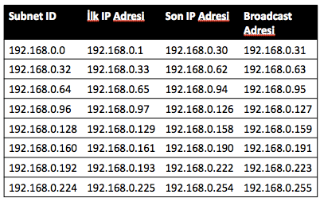
IP Adresi
192.168.0.0 255.255.255.0 networkunu 2 alt ağa ayıralım.
11111111.11111111.11111111.00000000 : 255.255.255.0 (Şuanli subnet mask)
11111111.11111111.11111111.10000000: 255.255.255.128 (Yeni subnet mask)
192.168.0.0/24′ ü 6 alt subnete bölelim.
11111111.11111111.11111111.00000000 : 255.255.255.0 (Şuanli subnet mask)
11111111.11111111.11111111.11100000: 255.255.255.224 (Yeni subnet mask)

Slide 6
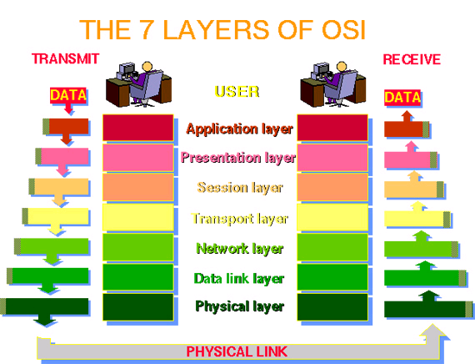
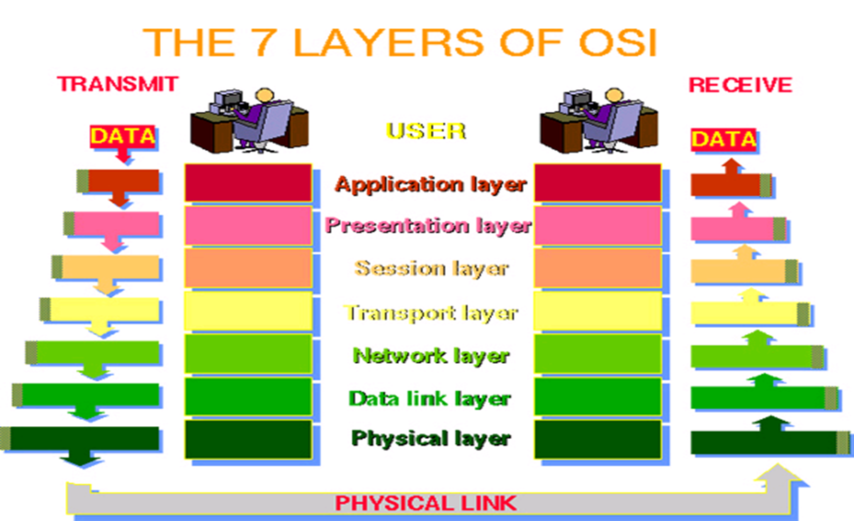
OSI Referans Modeli

Slide 7
Temel Kavramlar
Network Diagram
Network Tipleri (WAN, LAN, Peer to Peer)
  Fiber Kablolar
  Switch ve Hub Teknolojileri
  Server
  Topoloji Tipleri (Star, Bus, Ring)
  Firewall
  Routers
  Wireless Network
  Internet

Slide 8

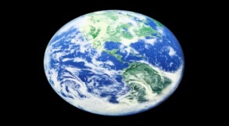

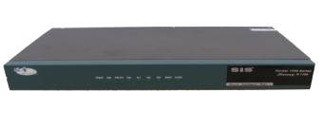
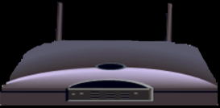
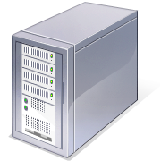
Network Diyagramı
Wired Network
PC
Firewall
The Internet
Fiber Optic Network Cable
Router
Switch
Server
Other LANS
Wireless Network
Notes:
I wanted to present this diagram to help the viewer visually understand how a computer network was set-up. I linked each component to the same text links throughout the project.

Slide 9

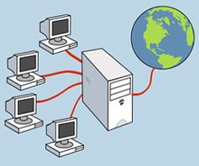
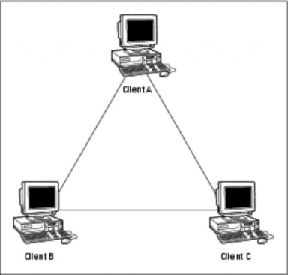
WIDE AREA
LOCAL AREA
PEER TO PEER
Notes:
I used this slide as a Introduction to the different types of networks. I tried to let the graphics do the talking on this slide. I elaborated more on each network type on subsequent slides.

Slide 10
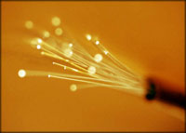
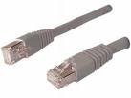
Fiber Kablo
Standard Network Copper Cable
Reduces interference in the network
Transmit data faster than copper network cable
Allows for more bandwidth
Smaller and more fragile than copper cable
Notes:
I felt this fiber optic cable graphic was a great graphic in that it, not only showed the fiber optic glass cables but, the colors fit in well with my project. I also wanted to show a small picture of a traditional wire cable just to contrast the two.

Slide 11
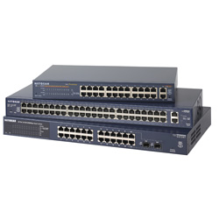
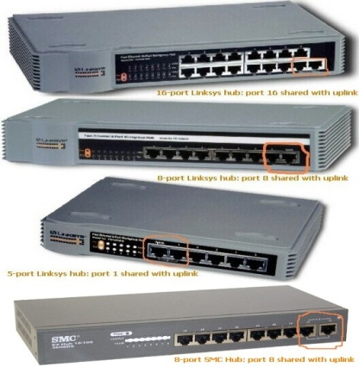
Switch ve Hub
Network Switch
Network Hub
Notes:
I used the same principle with switches and hubs as I did with the fiber optic cable in that I tried to contrast the newer component (switches) with the older ones (hubs). They two are hard to differentiate and look very similar but, I tried to outline the components below.

Slide 12

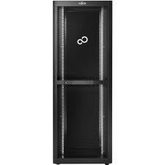
Server
Notes:
I used the same principle with switches and hubs as I did with the fiber optic cable in that I tried to contrast the newer component (switches) with the older ones (hubs). They two are hard to differentiate and look very similar but, I tried to outline the components below.

Slide 13
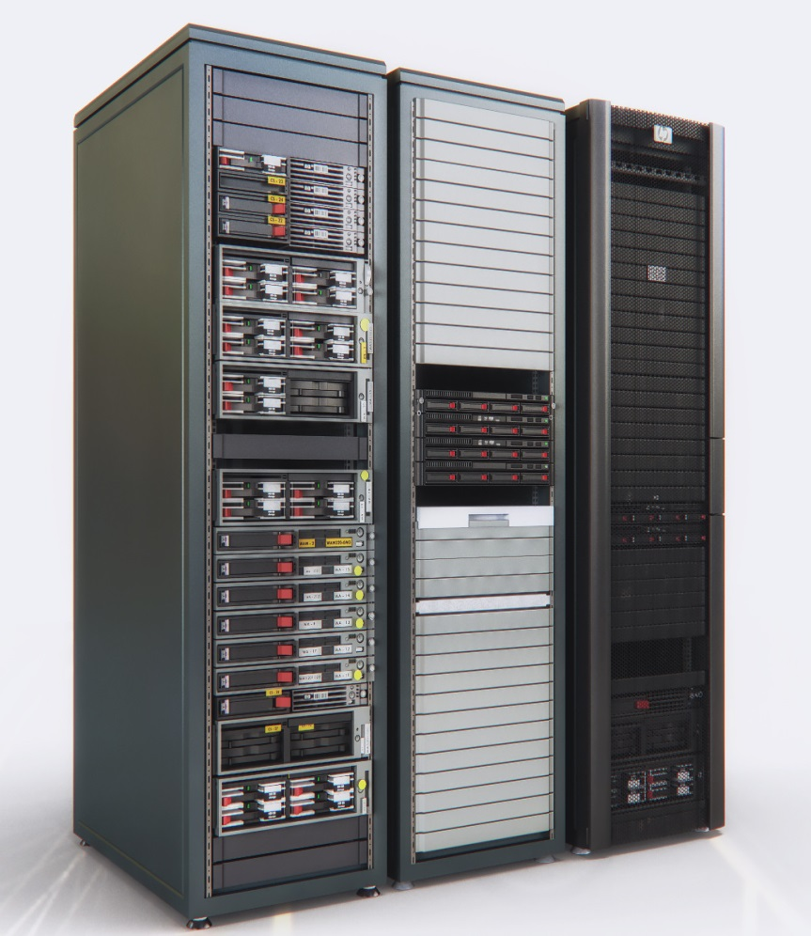
Server
Notes:
I used the same principle with switches and hubs as I did with the fiber optic cable in that I tried to contrast the newer component (switches) with the older ones (hubs). They two are hard to differentiate and look very similar but, I tried to outline the components below.

Slide 14
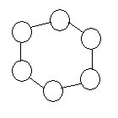
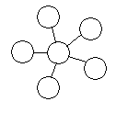

Network Topolojileri
Ring
Star
Bus
Notes:
I used the same principle with switches and hubs as I did with the fiber optic cable in that I tried to contrast the newer component (switches) with the older ones (hubs). They two are hard to differentiate and look very similar but, I tried to outline the components below.

Slide 15
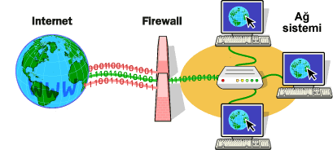
Firewall
Notes:
I used the same principle with switches and hubs as I did with the fiber optic cable in that I tried to contrast the newer component (switches) with the older ones (hubs). They two are hard to differentiate and look very similar but, I tried to outline the components below.

Slide 16
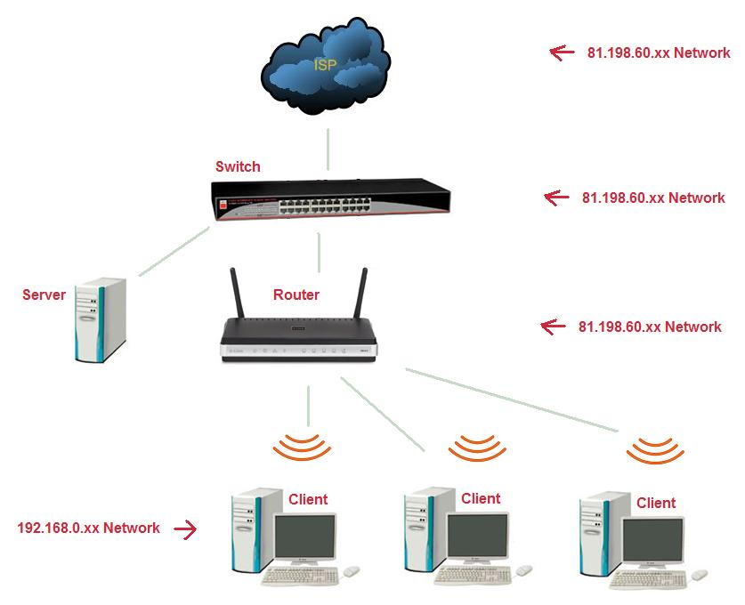
Router
Notes:
I used the same principle with switches and hubs as I did with the fiber optic cable in that I tried to contrast the newer component (switches) with the older ones (hubs). They two are hard to differentiate and look very similar but, I tried to outline the components below.

Slide 17
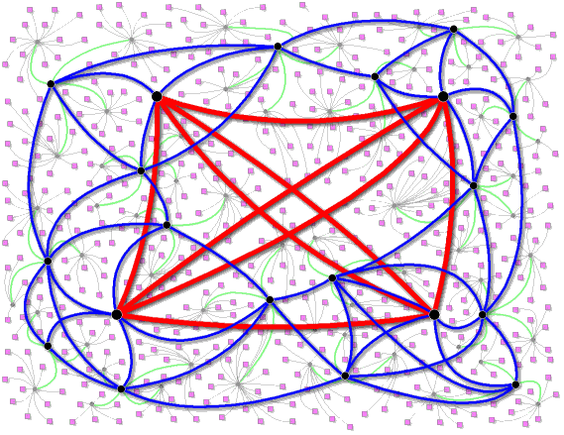
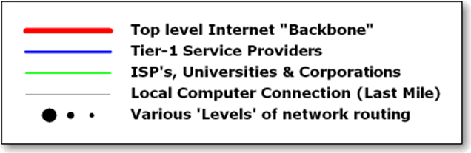
İnternet
Notes:
I used the same principle with switches and hubs as I did with the fiber optic cable in that I tried to contrast the newer component (switches) with the older ones (hubs). They two are hard to differentiate and look very similar but, I tried to outline the components below.

Slide 18
Title
Body text 1st layer
  Body text 2nd layer
    Body text 3rd layer
      Body text 4th layer
        Body text 5th layer

